Slide 1


YMCA of Metropolitan Milwaukee
Summer/Fall 2018
Fundraising Feasibility Assessments

Slide 2
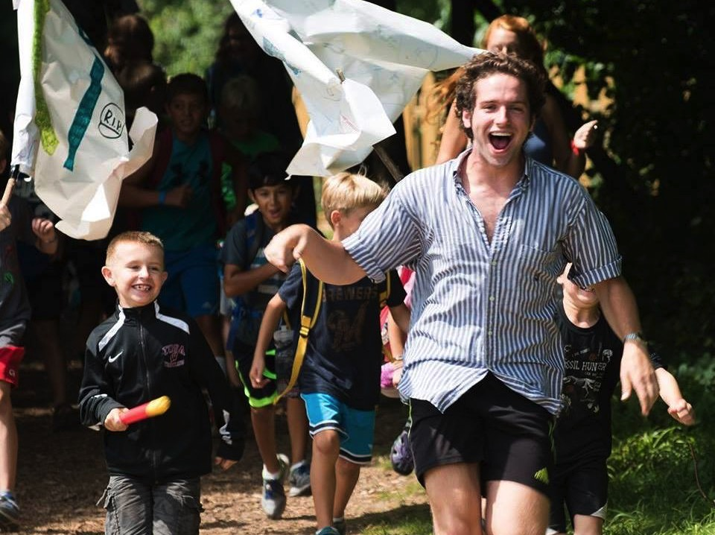
    YMCA Camp Minikani
    Feasibility Study • Summer 2018
Notes:
Personalize with photos from the client

Slide 3
Feasibility Study Goals
Image of the YMCA Metro Milwaukee & Camp Minikani
Opinion of the proposed plans and projected goal
Availability and potential of large gifts
Availability of potential leadership for the campaign
Timing, priority and strategy for the campaign

Slide 4
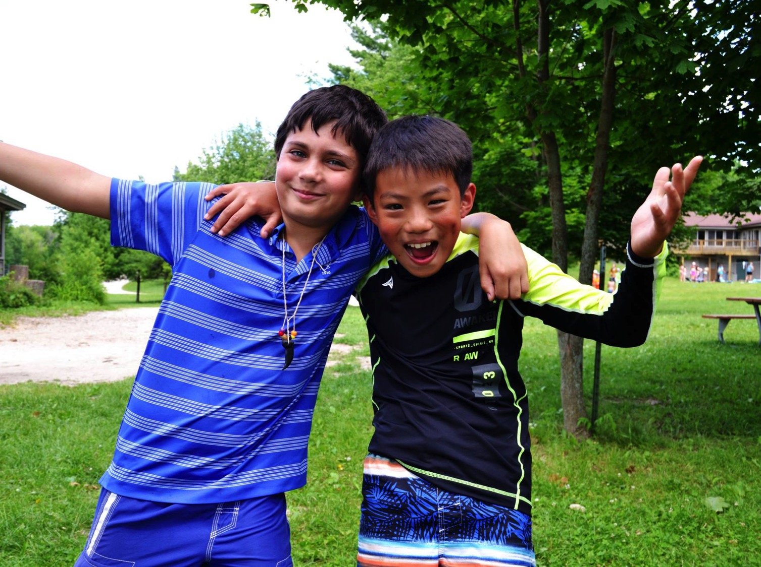
    Methodology &
    Scope of Work

Slide 5
Study Interviews
29 community leaders were interviewed in 26 face-to-face sessions. This list was vetted by staff and volunteers. Interviews tested the feasibility of raising $8,000,000 to support facility replacements and expansions.
In addition to Thom Peters or Robin Jordan from Donor By Design, Camp Minikani was represented by Jon McLaren, Executive Director or the camp in all interviews.

Slide 6
Key Questions
How do you feel about Camp Minikani and the YMCA?
How do you feel about the leadership of the Camp Minikani and the YMCA?
How do you feel about the proposed capital campaign?
How would you prioritize the projects?
How do you feel about the goal?
Where do think the top gifts will come from?
Who do you think must be involved in the leadership for the campaign to be successful?
Might you (personally) or your organization/company contribute to this effort?
How do you feel about launching a major initiative at this time?

Slide 7

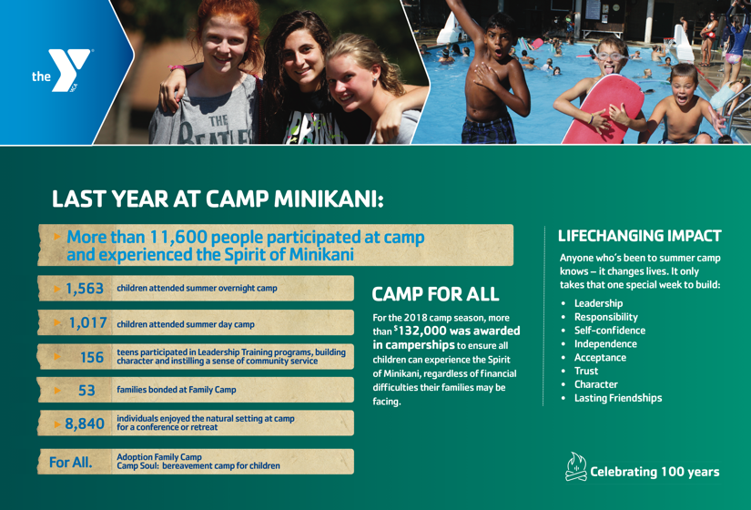
Study Materials
Notes:
Share a few printed documents…share how the interview process goes

Slide 8
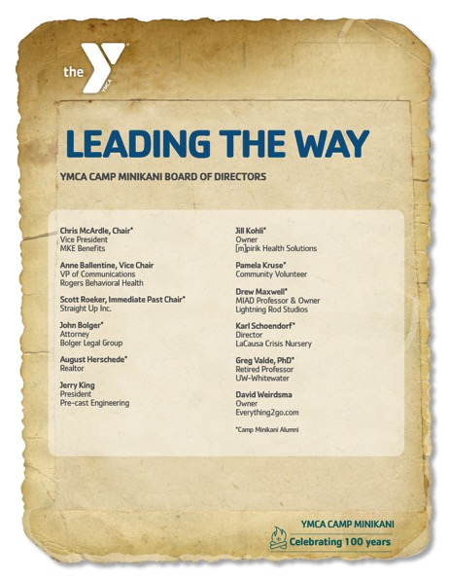
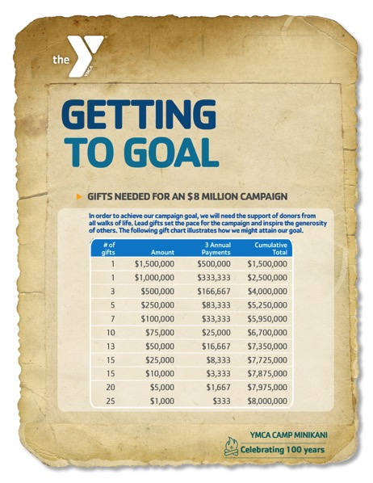
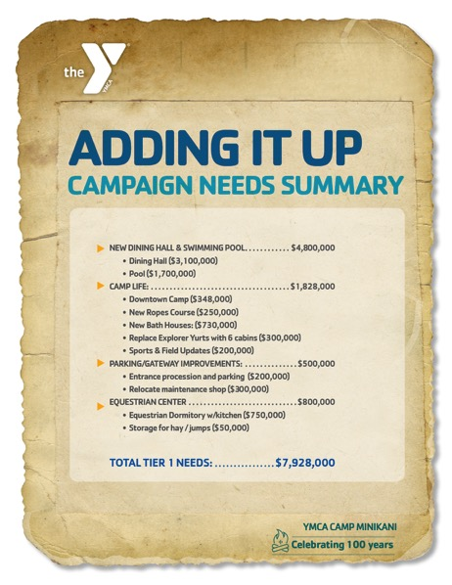
Study Materials
Notes:
Share a few printed documents…share how the interview process goes

Slide 9
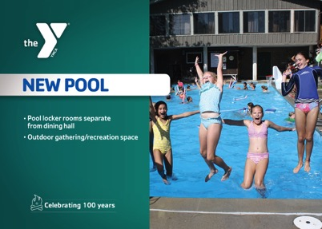
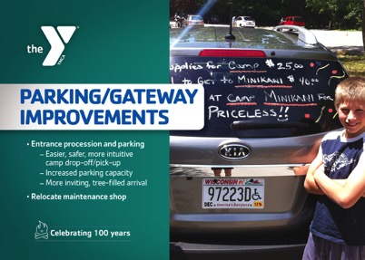
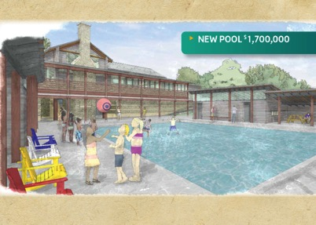

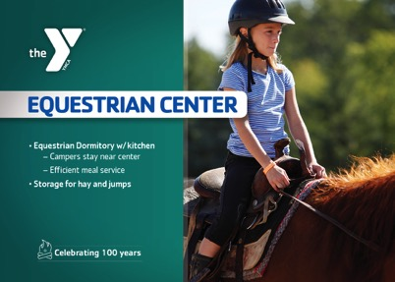
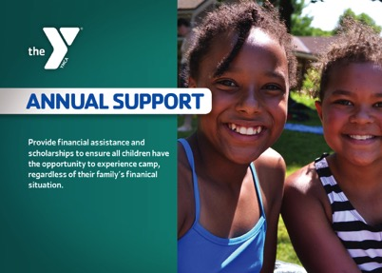


Study Materials
Notes:
Cards had $$$ on the back

Slide 10

    Interview Findings
    & Observations

Slide 11
Comparison Indicators
(based on similar projects)
Top-tier as compared to thousands of interviews;
no concerns
Mid-tier as compared to thousands of interviews;
need to be addressed to achieve desired
campaign goals
Lowest-tier as compared to thousands of interviews;
must be addressed prior to launching the
capital campaign

Slide 12
General Awareness and
Community Support
Are you familiar with YMCA Camp Minikani, its programs and activities?
Very Much So | Yes | Somewhat | No
77% | 23% | 0% | 0%
What is the most important benefit a community derives from the presence of YMCA Camp Minikani?
  Staff are positive role models
  Relationships
  Safe environment
  Life changing
  Character Values
  Great traditions
  Meeting kids who are different then you
  “Helped me be the person I am today”
  Light-hearted, fun, happy, silly place”

Slide 13
Image
What is the image of YMCA Camp Minikani in the community?
Very Good | Good | Fair | Poor | Don’t Know
88% | 12% | 0% | 0% | 0%
Comments on image:
Very good reputation
Highly regarded
Leadership
“Alumni want their kids to go there”

Slide 14
Organizational Leadership
Do you know the members of the Camp & Executive Boards of directors?
Yes | No | Most | Some | One or Two
16% | 0% | 16% | 29% | 39%
Would you say these individuals have the ability to raise major gifts?
Yes | No | Most | Some | Not Sure
0% | 0% | 0% | 50% | 50%
Is YMCA Camp Minikani & the YMCA of Metro Milwaukee viewed as well run and financially sound?
Most all felt strong with leadership but commented that they were concerned about the health of the Metro Y and that it could effect fund raising.

Slide 15
Proposed Projects
Do you think that YMCA Camp Minikani is on the right track with the projects outlined within this comprehensive campaign?
Yes | No | Not Sure
96% | 0% | 4%
Comments on Capital:
Didn’t realize there was so much year-round activity
Dining hall is important
Waterfront important – more than pool
Be cautious not to change the character of camp
“Seems extremely necessary”
“Parking isn’t sexy but can see security/safety issues”

Slide 16
Project Prioritization
New Dining Hall
Camp Life
Pool
Annual Campaign
Endowment
Parking/Gateway Improvements
Equestrian Center

Slide 17
Project Prioritization
Comments on project ranking:
Price tag: $3M – on Dining Hall much more reasonable than previously
Replacing yurts with your-round housing makes sense
New bath houses that meet standards are important
From day camper drop off perspective, can understand safety and security with new parking
While equestrian not seen as priority, increasing capacity of housing can be – “what is the ROI?”

Slide 18
Feasibility
Do you believe that a comprehensive campaign of $8,000,000 million is realistic and attainable over a 3-5 year period?
Yes | No | Not Sure
62% | 0% | 38%
Yes | No | Not Sure
85% | 0% | 15%
Are there individuals, businesses or foundations who have the ability to give these kinds of gifts over a 3-5 year period?
Comments on Goal and Area Capacity:
Phase projects – dining hall first
Case message will be important
Will take a significant lead gift
There is a strong alumni with resources

Slide 19
Feasibility and
Campaign Leadership
Would you personally consider making a gift to the proposed campaign?
Yes | No | NA
88% | 0% | 12%
Yes | No | Maybe | DK/NA
21% | 4% | 4% | 71%
Do you feel that your company/business would consider a gift to this project?
Would you be willing to take a leadership role, sit on a Campaign Leadership Cabinet or make a few key visits for the campaign?
Yes | Maybe | Don’t Know | No | Not Asked
85% | 0% | 4% | 0% | 12%

Slide 20
Community Receptivity and Environment
How would you assess the economic condition of the surrounding area at this time?
Very Good | Good | Fair | Poor
4% | 96% | 0% | 0%
Do you know organizations that are planning to conduct a campaign in the same time period?
Yes | No
33% | 67%

Slide 21
Community Receptivity and Environment
Does now appear to be an appropriate time to begin this campaign?
Yes | No | Maybe
100% | 0% | 0%
Comments on Timing:
Good timing with 100th anniversary
Will need for donors to be comfortable with Milwaukee
“Now is the time with camp full”
“We have to; can’t keep it the way it is”

Slide 22
Recommendations
Based on our interviews and the findings of the study we believe that YMCA Camp Minikani has the capacity and community support to launch a major comprehensive campaign in the range of $5,000,000 – $6,000,000.
Donor engagement at this level is strategic.
It takes time to secure six and seven-figure commitments. The majority of the top prospects identified in this study will need additional cultivation.

Slide 23
# of Gifts | Amount | 3 Annual Payments | 5 Annual Payments | Total
1 | $1,500,000 | $500,000 | $300,000 | $1,500,000
2 | $1,000,000 | $333,333 | $200,000 | $3,500,000
2 | $500,000 | $166,667 | $100,000 | $4,500,000
2 | $250,000 | $83,333 | $50,000 | $5,000,000
3 | $100,000 | $33,333 | $20,000 | $5,300,000
3 | $75,000 | $25,000 | $15,000 | $5,525,000
4 | $50,000 | $16,667 | $10,000 | $5,725,000
6 | $25,000 | $8,333 | $5,000 | $5,875,000
6 | $10,000 | $3,333 | $2,000 | $5,935,000
10 | $5,000 | $1,667 | $1,000 | $5,985,000
15 | $1,000 | $333 | $200 | $6,000,000

Slide 24
Recommendations
Case Development – A strong and urgent case must be developed for each capital project. The case must focus on the WHY and the So What— why will this investment make a difference and what will change at camp as a result?
Leadership is Everything. Consider Co-Chairs/Tri-Chairs for the campaign. Take time to engage well respected alumni & camp family leaders and secure their personal commitment to the project.
The Y needs to recruit a strong and connected Leadership Cabinet which includes both alumni leaders and current board leaders. Consider pairing existing key leaders with emerging leaders as you develop the leadership team. Also consider geography and camp eras.

Slide 25
Recommendations
  Secure a partnership or lead/challenge gift for each project.
  Project scope. Make sure construction pricing and project scope is solid as you begin fundraising for these projects. There was some earlier concern on project pricing, so reassure costs.
  Project priorities should be developed and aligned to donor interests. The dining hall is clearly the lead, but there is interest in some of the camp life projects that could be connected to key prospects.
  Assure confidence that all funds will go to camp projects with donor contracts & restricted gifts. Use confidence in current leadership.

Slide 26
Recommendations
  A communication campaign must be developed and executed lifting up the life-changing work of the camp. Camp is in a strong position with enrollment, but this has also created some concern for next summer. The year-round work and expanded leadership opportunities should be highlighted.
  Specific donor engagement plans must be developed for your Top 20/Next 30 prospects. Donor cultivation is needed—speed dating doesn’t work in major gift fund development.

Slide 27
Recommendations
  Evaluate and ensure necessary development infrastructure to support a successful campaign.
  Develop a diverse and attractive list of naming opportunities for all capital projects.
  Camp Endowment Case – In addition to unrestricted endowment, consider endowment requests as part of a comprehensive approach to donors as appropriate.
  Re-engage key study participants with a “report to the community” document to review assessment findings, explore next steps in their engagement and communicate the camp’s plans to move forward.

Slide 28
Next Steps
Project scope and priorities: Develop not just a list of priorities based on giving interest, but make sure cost expectations are clear.
Campaign Case: There is a strong expressed need, not put together the impact projects will have with these needs.
Leadership: Recruit Chairs and begin to identify leadership.
Identify Top 20/Next 30 prospects and develop donor engagement strategies. Start cultivation with top gift prospects.
Develop a campaign plan and timeline.

Slide 29
    YMCA of Metropolitan Milwaukee
    Endowment Branch Projects • Fall 2018
Notes:
Personalize with photos from the client

Slide 30
Study Interviews
12 community leaders were interviewed in 10 face-to-face sessions. This list was vetted by staff and volunteers. Interviews tested the feasibility of raising $5,800,000 for:
Northside $318,000
Rite-Hite $2,242,000
Endowment $3,000,000
Neighborhood Expansion $TBD
In addition to Bruce Berglund from Donor By Design, the Y was represented by Carrie Wall, President / CEO.

Slide 31
Image
What is the image of YMCA Camp Minikani in the community?
Very Good | Good | Fair | Poor | Don’t Know
0% | 40% | 60% | 0% | 0%
Comments on image:
The Y has been invisible since bankruptcy
The Y is no longer a philanthropic player in the city
The Y is still well regarded from those it serves
The Y’s image is muddled and in transition
The Y isn’t telling its story
The Y staff are well regarded
The bankruptcy is more fresh for board members – old news for the community

Slide 32
Proposed Projects
Do you think that YMCA is on the right track with the projects outlined within this campaign?
Yes | No | Not Sure
80% | 10% | 10%
Comments on Capital:
Don’t shy away from capital needs
Program for kids and families is stronger than the capital projects served up
A realistic and small capital goal would be a good way to “walk” before you run back into major gift fundraising
It’s not the right time to talk about endowment development

Slide 33
Project Prioritization
Rite Hite
Northside
Annual Campaign
Neighborhood Expansion
Endowment

Slide 34
Feasibility
Do you believe that a comprehensive campaign of $5,800,000 million is realistic and attainable over a 3-5 year period?
Yes | No | Not Sure
30% | 0% | 70%
Yes | No | Not Sure
40% | 0% | 60%
Are there individuals, businesses or foundations who have the ability to give these kinds of gifts over a 3-5 year period?
Comments on Goal and Area Capacity:
Consider $3MM - $3.5MM goal + camp campaign
Endowment was ranked last by most of the interviews
Annual campaign not connected to program needs

Slide 35
Feasibility and
Campaign Leadership
Would you personally consider making a gift to the proposed campaign?
Yes | No | NA
60% | 0% | 40%
Yes | No | Maybe | DK/NA
33% | 11% | 34% | 22%
Do you feel that your company/business would consider a gift to this project?
Would you be willing to take a leadership role, sit on a Campaign Leadership Cabinet or make a few key visits for the campaign?
Yes | Maybe | Don’t Know | No
10% | 60% | 10% | 20%

Slide 36
Recommendations
Based on our interviews and the findings of the study we believe that the YMCA of Metropolitan Milwaukee has the capacity to raise $3,000,000 – $3,500,000 for the projects tested.
Based on our interviews, we would recommend not launching an endowment initiative at this time.
Comprehensive
Campaign

Slide 37
Recommendations
Comprehensive Campaign – considering the results of both studies: launch a $10,000,000 comprehensive campaign to support:
- YMCA Camp Minikani
- Rite Hite YMCA
- Northside YMCA/Early Childhood Education Expansion
- Neighborhood Expansion
Leadership – It’s recommended that Camp have a traditional Leadership Cabinet. Conversely, the Association Campaign have 6-8 key volunteers who will make 20 key asks.

Slide 38
Recommendations
Positioning. The YMCA of Metropolitan Milwaukee needs to start telling its story again. Camp should be part of this wonderful story. Celebrate the 160th Anniversary over the next 12 months.
Specific donor engagement plans must be developed for those who may be combined asks for both camp and association projects. Engagement and solicitation must be coordinated.

Slide 39
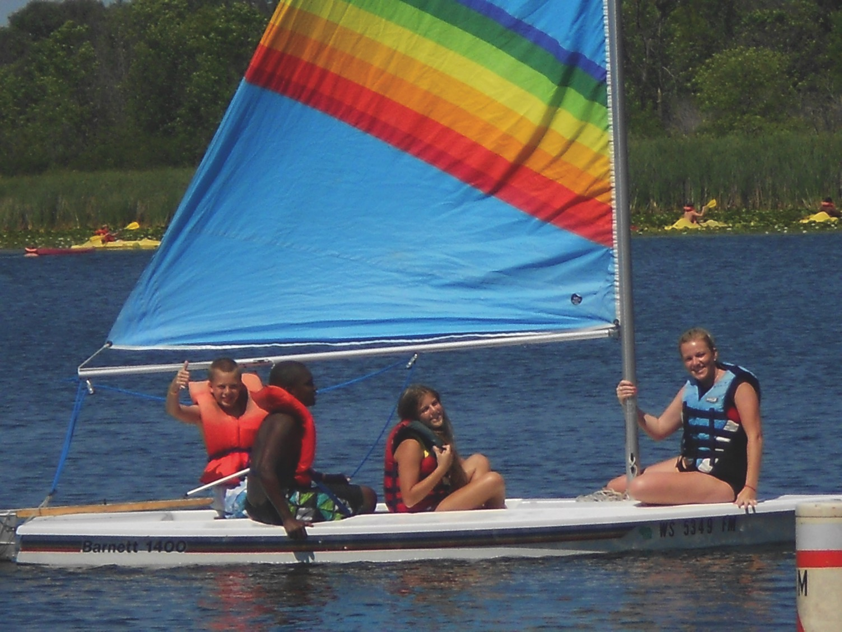
Questions?

